Slide 1

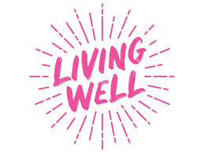
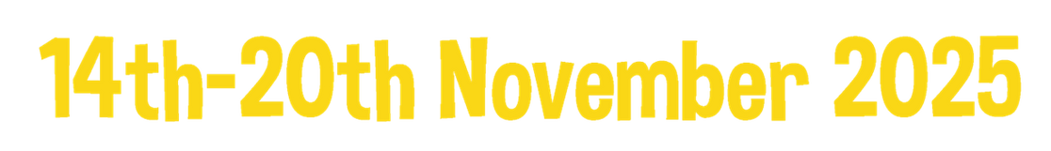


Bringing Your Own Baby Week To Life
h
Caring for you, Caring for baby
The Living Well Team

Slide 2

Introduction
Baby week runs from the 14ᵗʰ- 20ᵗʰ November every year
It aims to make the UK the best place to grow up by celebrating services, raising awareness about the importance of early childhood and promoting the best start in life
The theme for baby week this year is “Healthy Parent, Healthy Baby”
This pack is designed to help you make the most of Baby Week
It breaks down into themes that you can use across the week
It will give you places you can find activities to singpost parents to, or to use in family groups or one-to-ones
As well as places where you can find activities to use in practice

Slide 3
How Early Years Settings Support Families
The early years are crucial for brain development, emotional wellbeing, and future life chances. A strong start helps children grow into healthy, confident, and resilient adults.
Early years settings help by:
Promoting health: providing good food, encouraging exercise, and providing emotional support
Supporting development: learning through play and spotting issues early
Empowering families: parenting advice and signposting to services
Building community: creating safe, inclusive spaces for children and families
Baby week is a week to celebrate all this work and let families know what they can do at home.

Slide 4
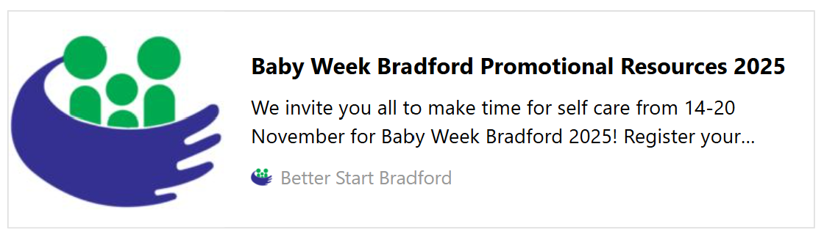

Baby Week Promotion
Download everything you need to:
Promote your own Baby Week Bradford events and activities
Help us spread the word about Baby Week Bradford across the district
Or find out about local events running in Bradford for Baby Week

Slide 5





Topics To Use This Baby Week
BONDING
FOOD
PLAY
SLEEP
YOURSELF
Slides 6-9
Slides 10-13
Slides 14-17
Slides 18-21
Slides 22-25

Slide 6

Connecting with your baby through BONDING
Parents might not realise how small things can make a big difference to their babies' health and happiness. One way to explain this to families is through a visual metaphor.
Children’s brains are a lot like ropes; they are made of many different strands. Three of these strands are how they learn to talk, how they express their feelings, and how they form friendships.
Every time someone talks to a child or responds to them, they are helping these strands grow strong. And the stronger each strand is, the stronger their brain will be overall.
All these little moments add up to something much bigger, giving children the skills they need to develop into healthy, bright adults.
Notes:
4

Slide 7
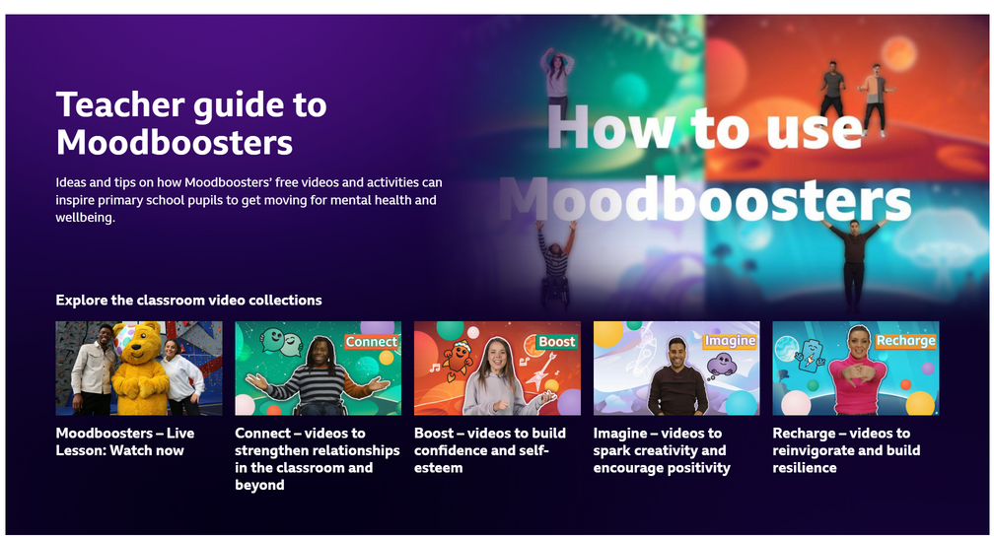

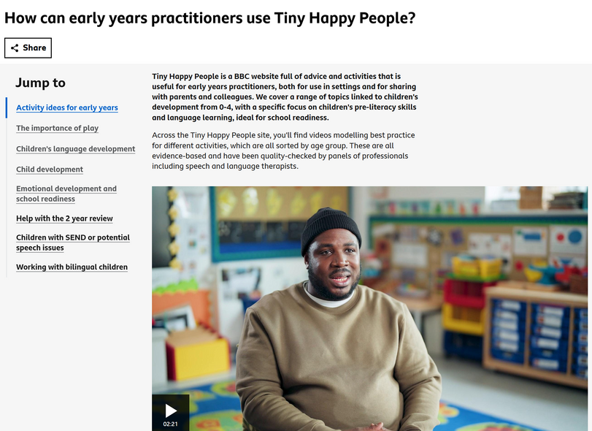
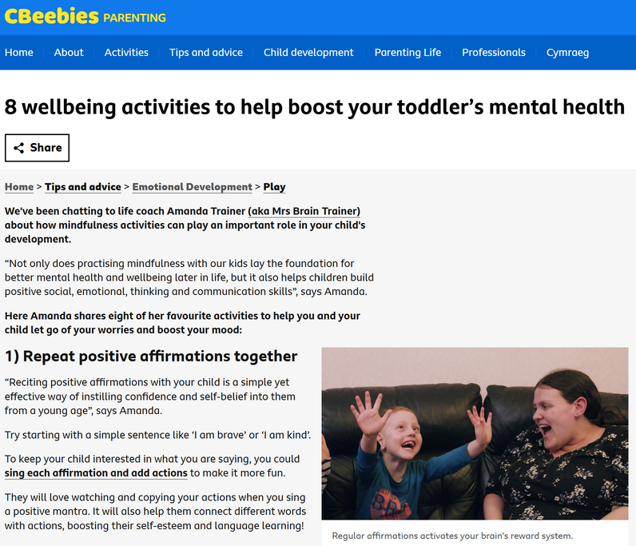
Connecting with your baby through BONDING - for Settings
CBeebies Parenting, also known as Tiny Happy People, offers practical advice and fun ideas to help families strengthen their bonds during the early years.
CBeebies Parenting aims to help parents navigate key challenges, and it also has specific advice on how early years practitioners can use the site.
Their resources include videos and blog posts packed with expert tips, such as ways to make storytime more interactive, encourage play that builds emotional connection, and create calm routines for bedtime.
Notes:
4

Slide 8
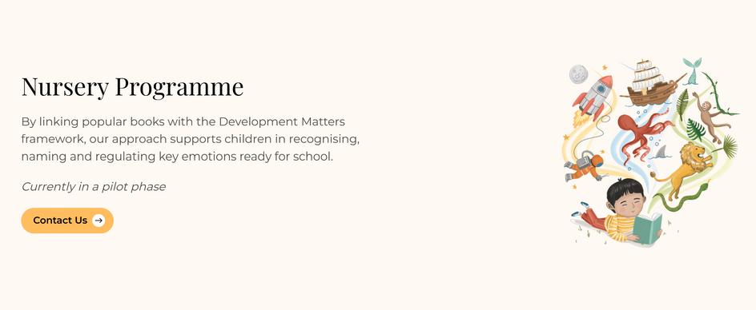
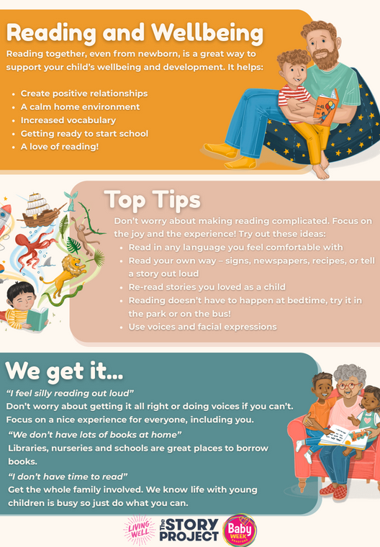
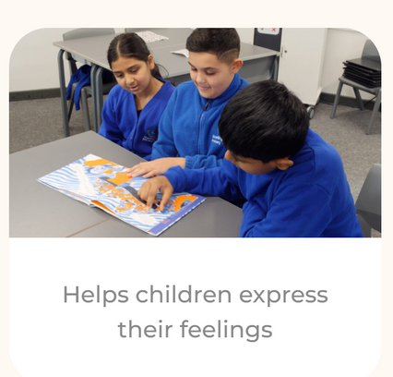
Connecting with your baby through BONDING - for Settings
The Story Project has created a set of bespoke, free resources for Baby Week that families can use at home or practitioners can share.
These resources show how bonding and emotional development can be supported through stories in a simple, family-friendly way.
What’s included:
Tips for Families Flyer – quick ideas to make reading fun and meaningful
Guided Activity – using The Colour Monster to explore feelings
Video – practical advice on getting started with reading together
Notes:
4

Slide 9
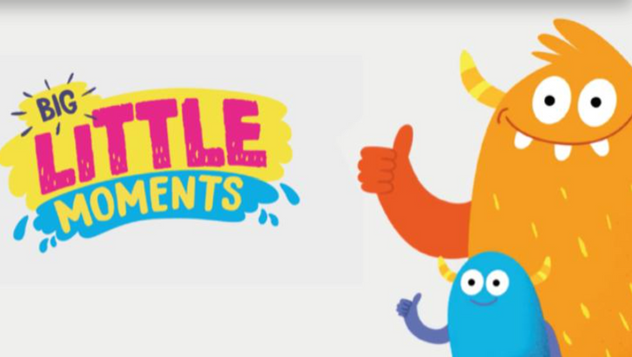
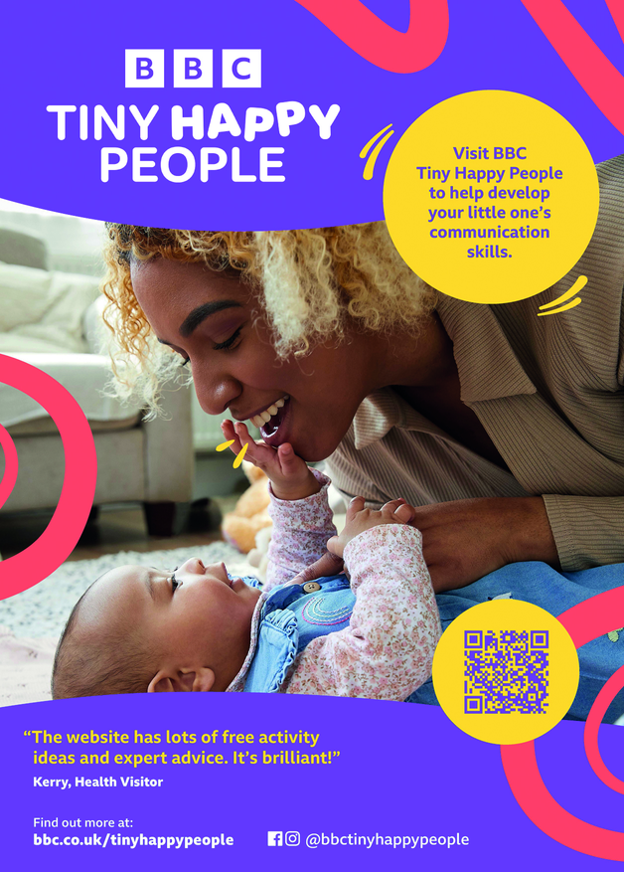
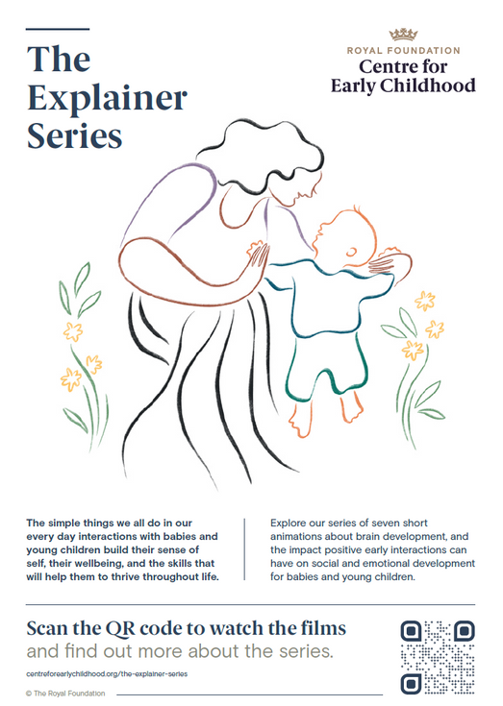

Connecting with your baby through BONDING - to Share
Notes:
4

Slide 10
Connecting with your baby through FOOD
Nutrition in the first five years is crucial for children’s health, development, and lifelong eating habits. During this time, families experience many changes in how and what their child eats.
Early years practitioners play a vital role in laying the foundations for a healthy diet and supporting families to do the same at home. Settings provide unique opportunities for babies and young children to explore a variety of foods, sometimes trying things they may not have access to at home.
Parents trust early years settings, which puts practitioners in an amazing
position to share advice and signpost families to reliable
resources.
Notes:
5

Slide 11
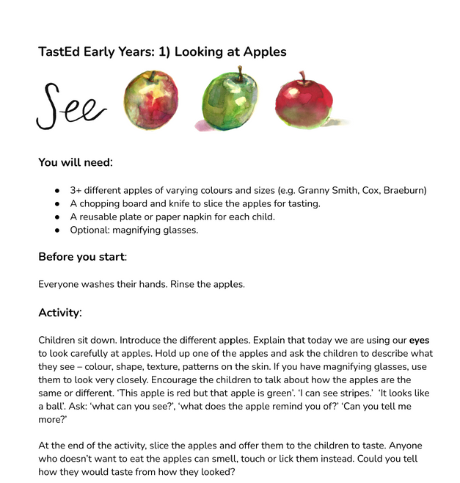
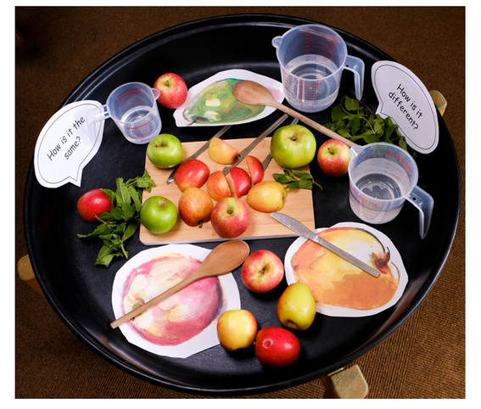
Connecting with your baby through FOOD - for Settings
Taste Education is a website featuring a range of resources that cover food education, specifically focusing on exploring food through the senses.
The sessions aim to increase children's willingness to try new foods.
TastEd can make the existing curriculum more engaging and easier to deliver. Resources are designed to provide the core EYFS curriculum.
There are 18 different activities available.
Notes:
5

Slide 12
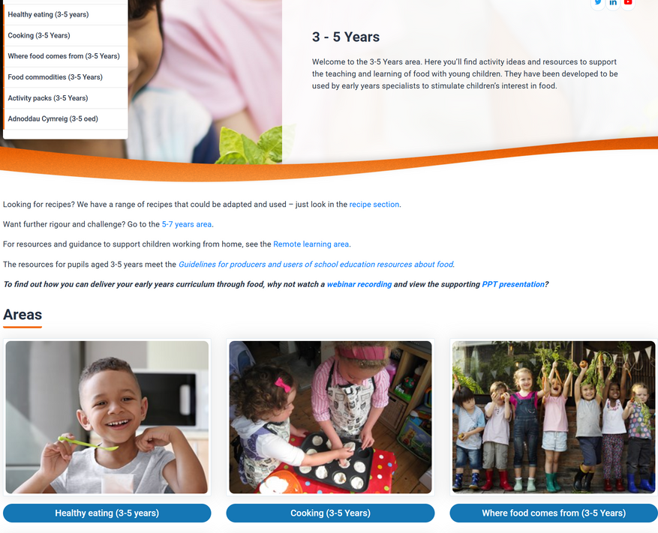
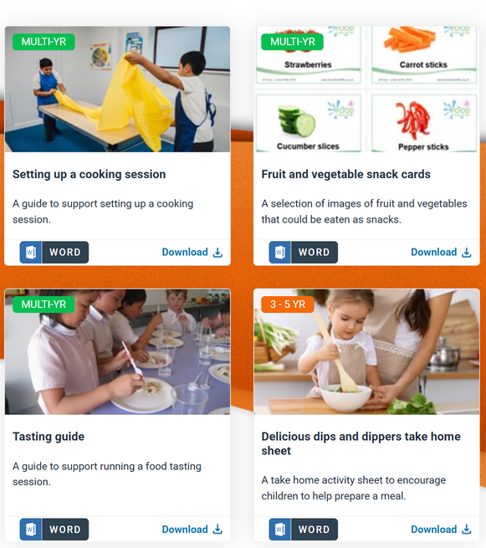
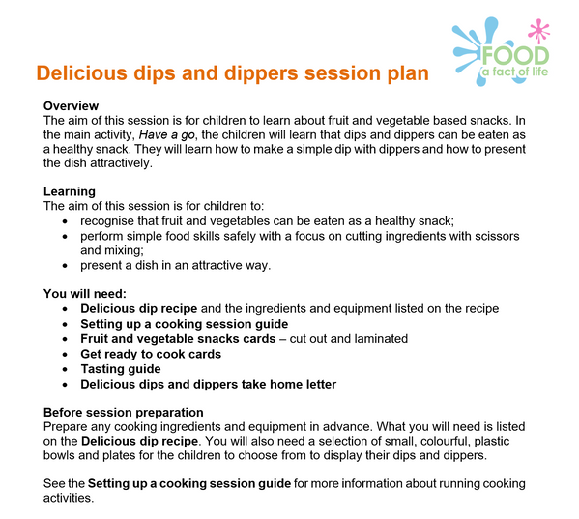
Connecting with your baby through FOOD - for Settings
Food a fact of life is a website that includes a range of resources covering food education.
There are resources for pupils aged 3-5 years old that meet the guidelines for school education about food.
They have lessons and activities on the following topics:
Healthy Eating
Cooking
Where Food Comes From
Food Commodities
And activity packs covering:
Vegetables
Food Challenges
Specific food based sessions
Notes:
5

Slide 13
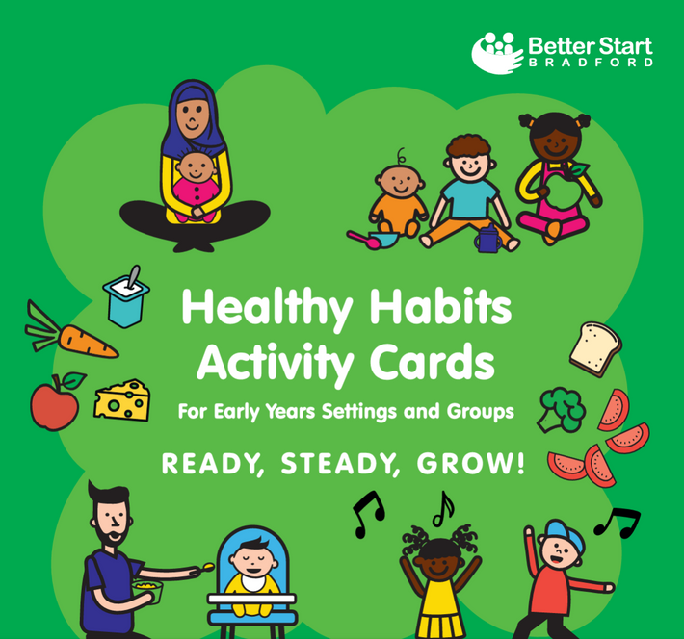
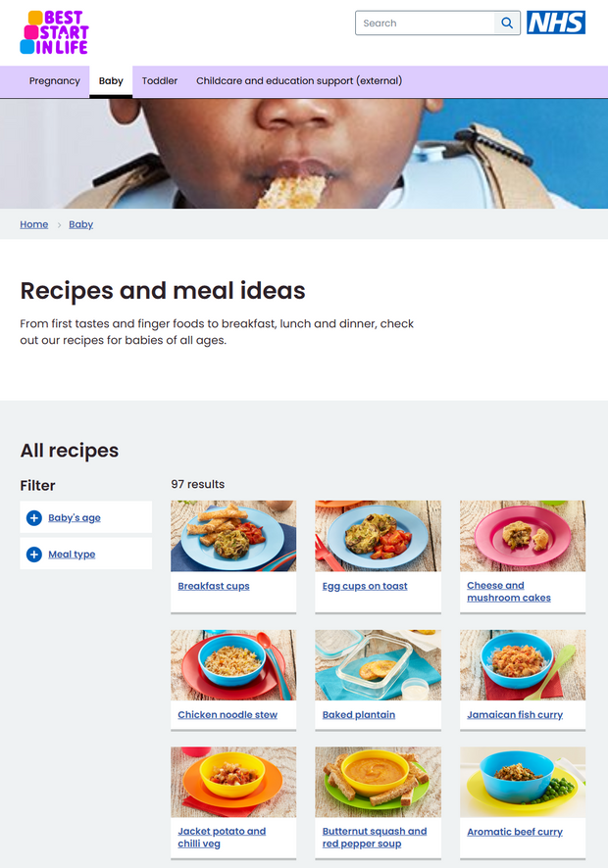
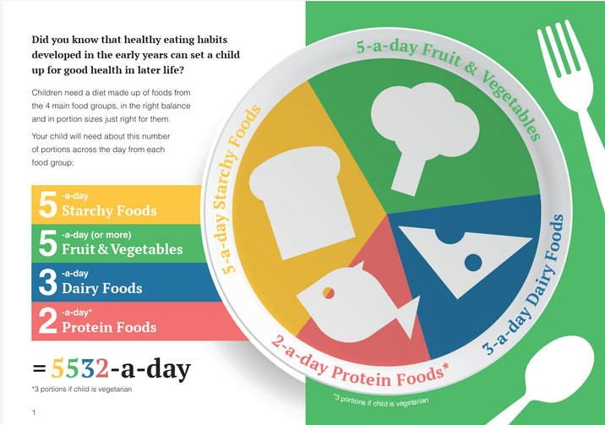
Connecting with your baby through FOOD - to Share
Notes:
5

Slide 14
Connecting with your baby through PLAY
Play isn’t just about keeping children entertained; it’s a powerful tool for learning and wellbeing.
When a child builds a tower of blocks, they’re developing problem-solving skills and fine motor control. Running, jumping, and climbing? Those activities strengthen muscles, improve coordination, and support physical health. Imaginative play, such as pretending to be a doctor or a chef, helps children understand their emotions and develop social skills.
Not everyone understands this link; play can be seen as something children
do. By prioritising play in your setting and helping families to learn
the importance of play and that every playful moment is an
opportunity to grow, you will help families to prioritise play
at home.
Notes:
6

Slide 15
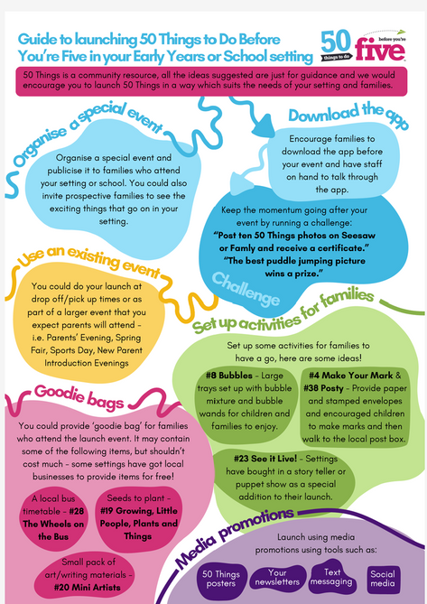
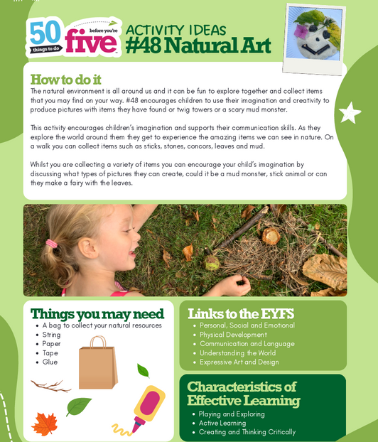
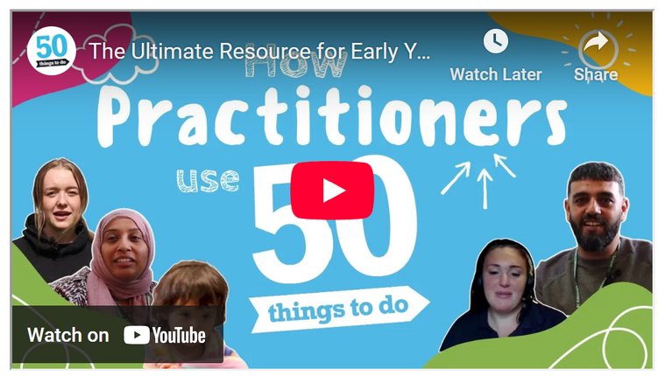
Connecting with your baby through PLAY - for Settings
The 50 Things to Do Before You’re 5 initiative gives nurseries a practical toolkit to enrich play and learning.
Each activity is designed to be simple, low-cost, and rooted in everyday experiences, helping children develop language, creativity, and physical skills.
They have resources so you can understand how your Early Years setting can make the most of 50 Things to Do Before Your 5.
Notes:
6

Slide 16
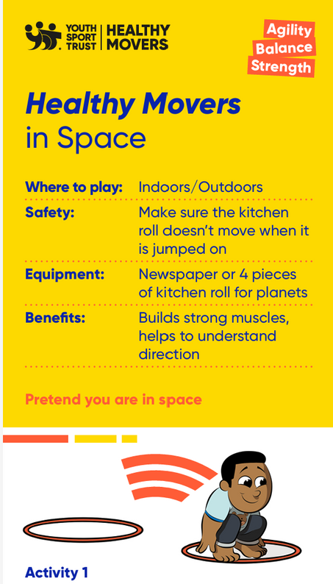
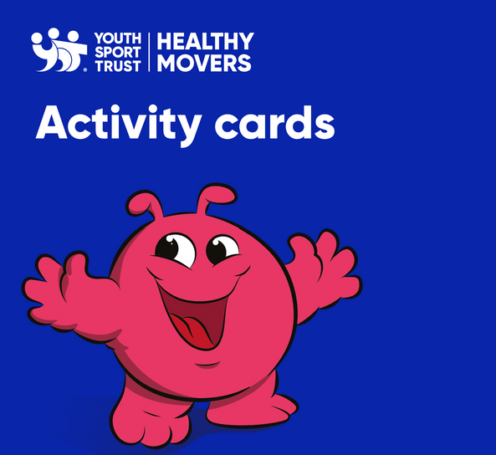
Connecting with your baby through PLAY - for Settings
The Youth Sport Trust’s Healthy Movers digital resources help practitioners incorporate active play into daily routines.
They offer simple, fun activities that develop physical skills, confidence, and communication, while supporting EYFS goals.
Resources include easy guides for indoor and outdoor play, wellbeing tips, and ideas to involve families, making movement enjoyable and purposeful.
These can be used in a setting, with families or promoted to families to use at home.
Notes:
6

Slide 17
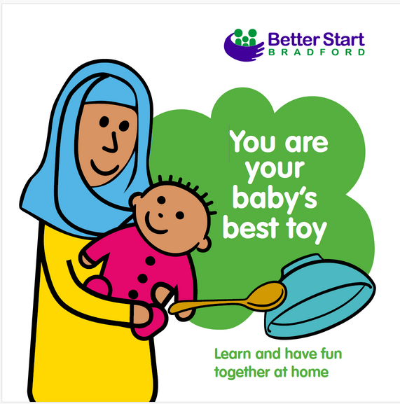
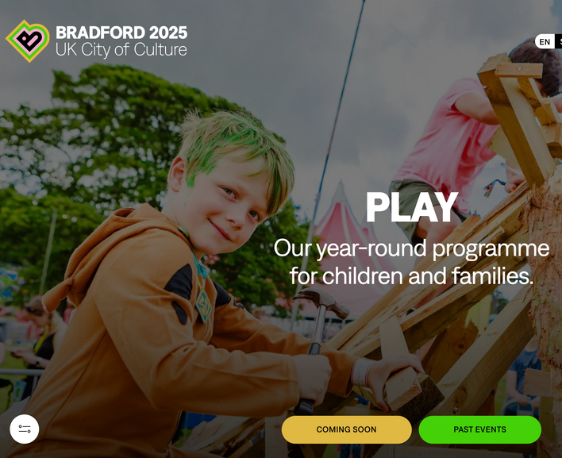
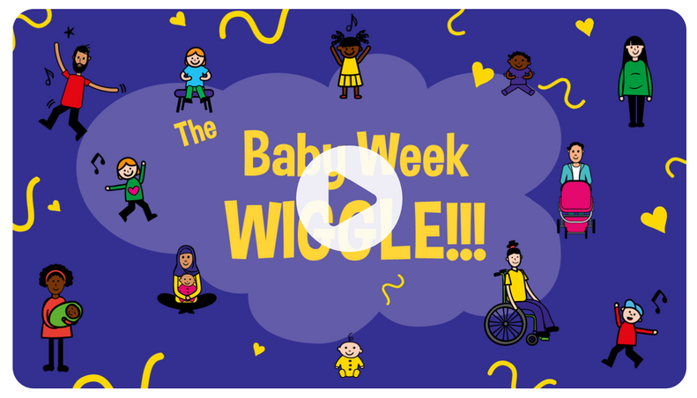
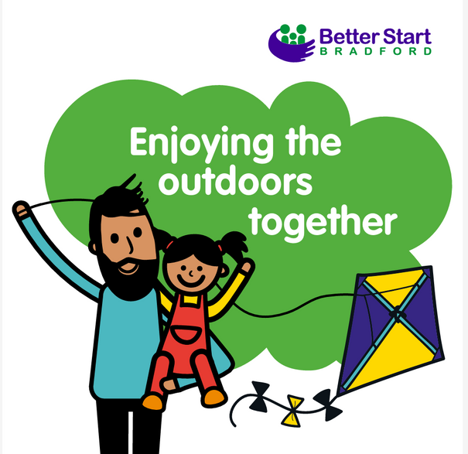
Connecting with your baby through PLAY – to Share
Notes:
7

Slide 18
Connecting with your baby through SLEEP
A safe and sufficient amount of sleep is essential for a baby's health, wellbeing, and development.
Quality sleep supports brain growth, emotional regulation, and physical health. When families are struggling to get babies or children to sleep, the whole family's routines and wellbeing can be affected.
Early years settings play a vital role in a baby's or young child's health and wellbeing through creating safe sleep environments, noticing sleep patterns and sharing concerns with families
in a sensitive way. As well as directing parents to trusted resources, guidance
for practical tips and reassurance.
Notes:
8

Slide 19
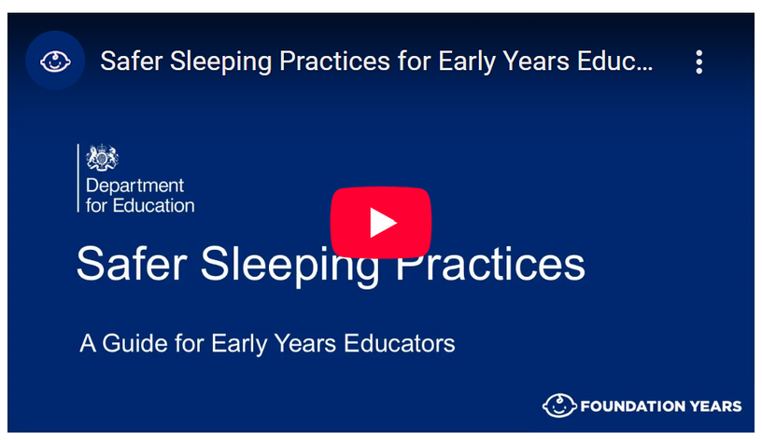
Connecting with your baby through SLEEP - for Settings
The Department for Education’s guide helps practitioners create safe sleep environments for babies and young children.
It includes key recommendations and practical resources, such as posters and checklists for staff training and daily practice.
Notes:
6

Slide 20
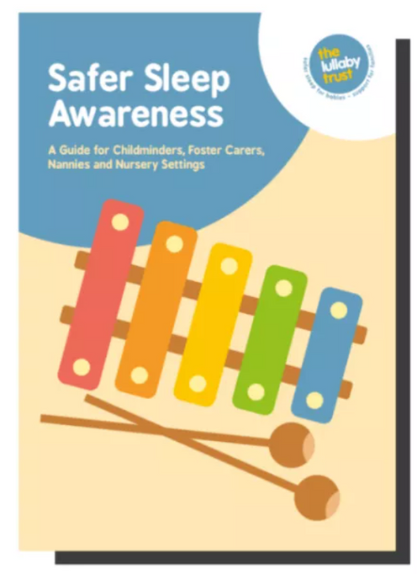
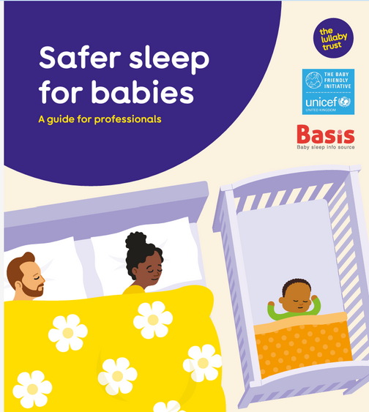
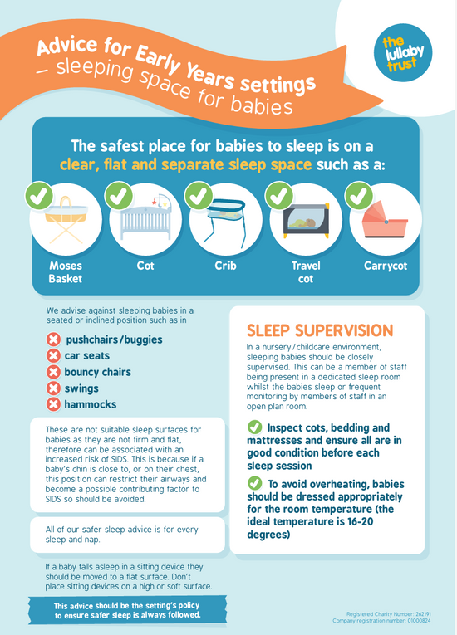
Connecting with your baby through SLEEP - for Settings
The Lullaby Trust provides evidence-based guidance and practical tools to help practitioners create safe sleep environments, offering advice that can be shared with families to promote a healthy sleep environment.
They have specific resources and guidance for professionals and early years settings.
They also offer a range of resources, including display posters, leaflets, and digital screen displays, to use throughout your setting or with families.
Notes:
6

Slide 21
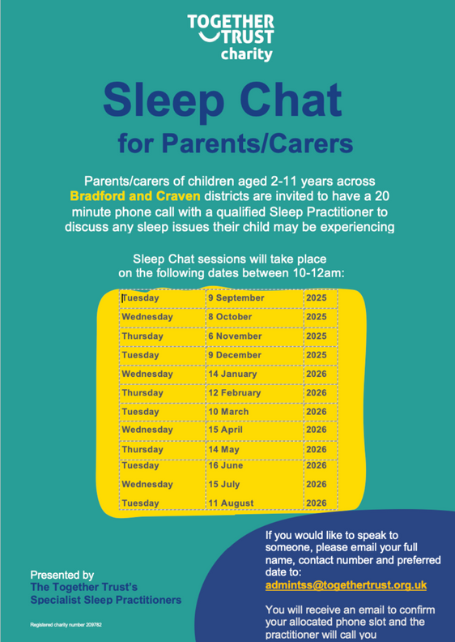
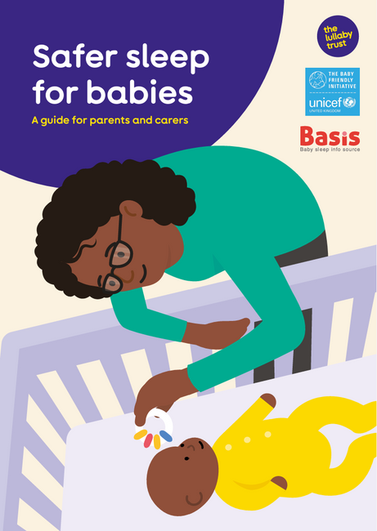
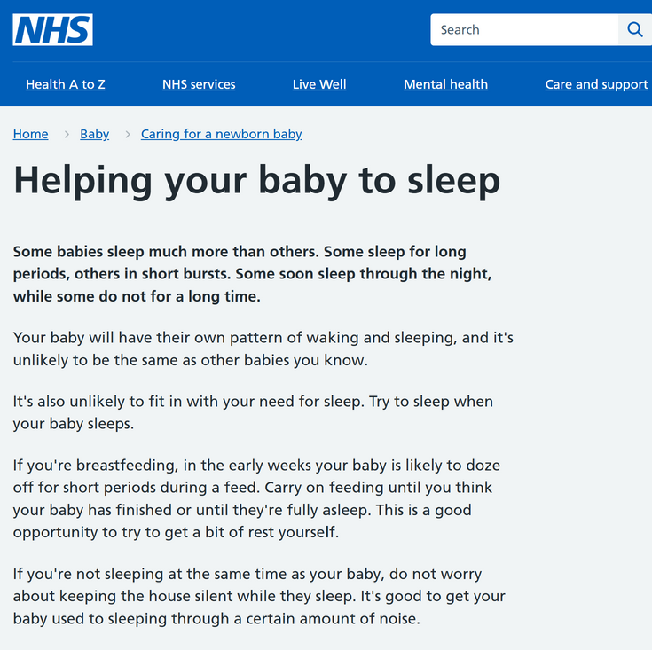
Connecting with your baby through SLEEP – to Share
Notes:
7

Slide 22
Connecting with your baby, through connecting with YOURSELF
When settings prioritise wellbeing for both staff and families, they build strong partnerships that support children’s emotional, physical, and social growth.
When practitioners feel supported and valued, they create calm, nurturing environments where children feel safe and secure. Positive relationships between adults and children are essential for emotional regulation, learning, and resilience.
Families who feel supported are better able to provide stability and care, which benefits children’s overall development.
Early years settings play a key role in this by creating welcoming spaces,
encouraging open conversations and sharing practical advice.
Signposting families to trusted resources and local services
can make a real difference.
Notes:
9

Slide 23
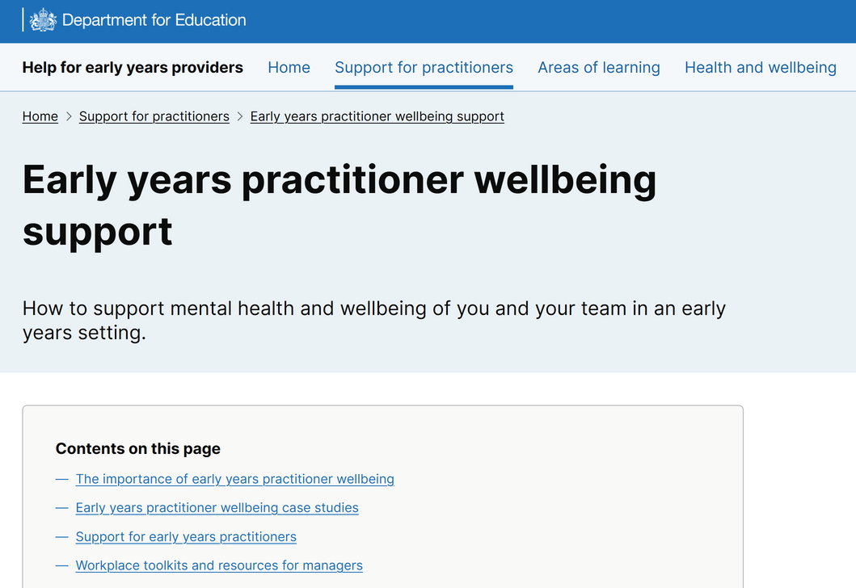
Connecting with your baby through YOURSELF - for Settings
The Department for Education’s Early Years Practitioner Wellbeing Support guide helps settings create a positive environment for staff and children.
Practitioners can use it to:
Embed wellbeing practices: apply tips and examine case studies on what other settings have done to reduce stress and strengthen team relationships.
Access practical tools: utilise workplace toolkits and resources to support managers in promoting mental health within their daily routines.
Notes:
6

Slide 24
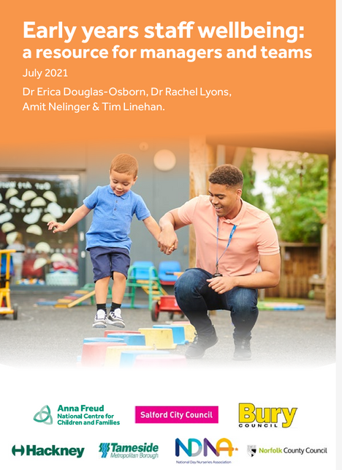
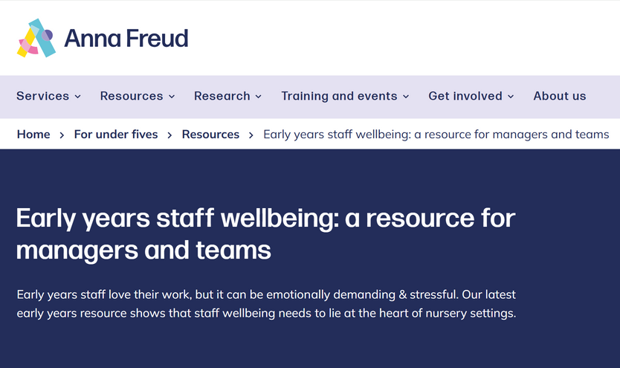
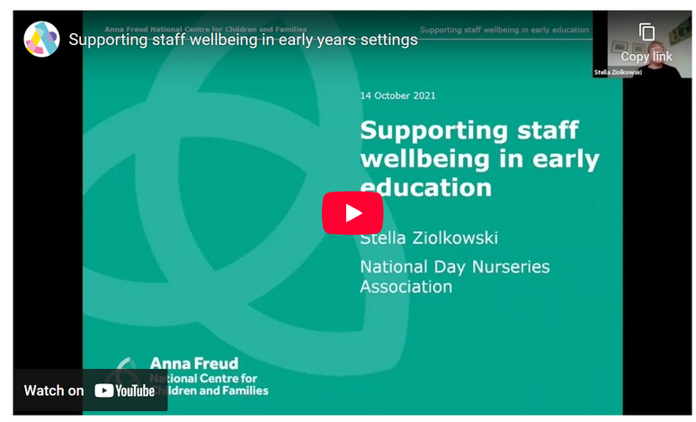
Connecting with your baby through YOURSELF - for Settings
Anna Freud has numerous resources to support the wellbeing of staff and families.
Resources include:
Practical tools: guides, checklists, and conversation starters to embed wellbeing into daily practice.
Signposting materials to share with families and staff: resources and advice to promote emotional resilience both in settings and at home.
Notes:
6

Slide 25
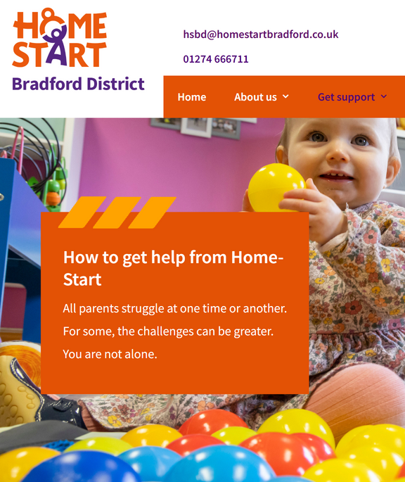
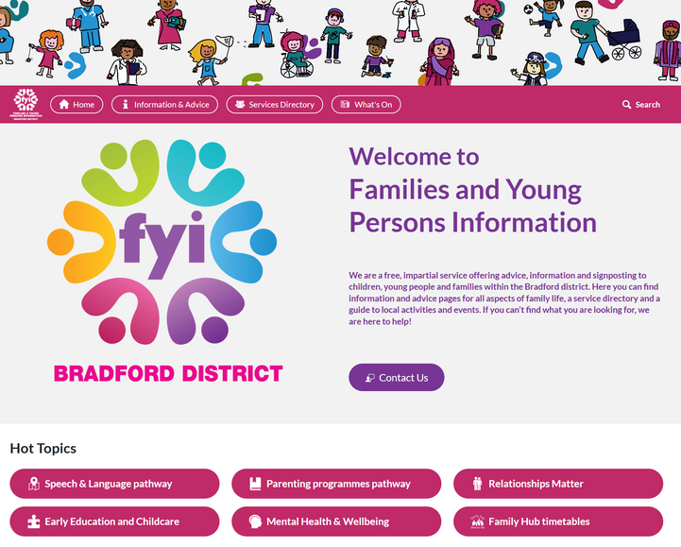
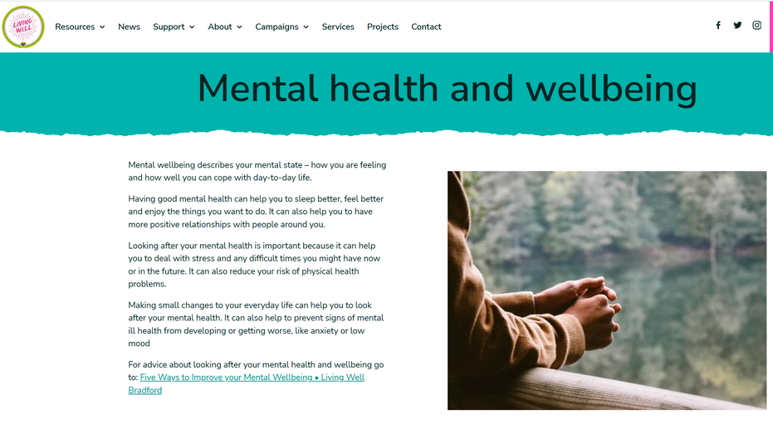
Connecting with your baby through YOURSELF – to Share
Notes:
7

Slide 26
From everyone at Living Well, we wish you a wonderful Baby Week!
If you want to find out more about health and wellbeing contact - Lydia.carter@bradford.gov.uk or Oliver.Timms@bradford.gov.uk

